Slide 1
TEMPORARY VERSUS PERMANENT ACCOUNTS
TEMPORARY (NOMINAL) PERMANENT (REAL) These accounts are closed These accounts are not closed
All revenue accounts All asset accounts
All expense accounts All liability accounts
Owner’s drawing Owner’s capital account

Slide 2
CLOSING ENTRIES
Closing entries
  Formally transfers net income (loss) and owner’s drawings to owner’s capital
  Journalizing and posting is a required step in the accounting cycle
Income Summary
  A temporary account
  Used in closing revenue and expense accounts
  Minimizes the details in the permanent owner’s capital account

Slide 3
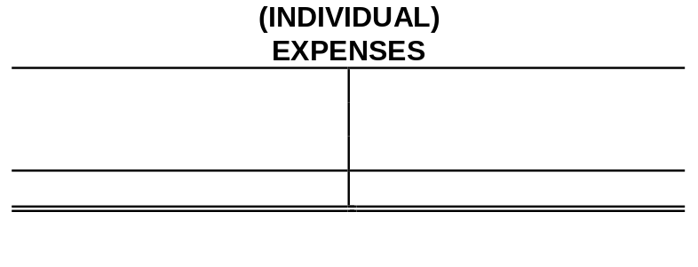
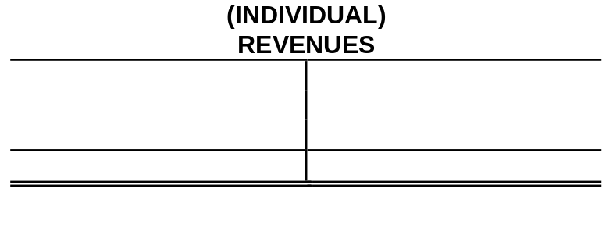

DIAGRAM OF CLOSING PROCESS
PROPRIETORSHIP
2
1
1 Debit each revenue account for its balance, and credit Income Summary for total revenues.
2 Debit Income Summary for total expenses, and credit each expense account for its balance.

Slide 4


DIAGRAM OF CLOSING PROCESS
3
3 Debit (credit) Income Summary and credit (debit) owner’s capital for the amount of net income (loss).

Slide 5

DIAGRAM OF CLOSING PROCESS
4
4 Debit owner’s capital for the balance in the owner’s drawing account and credit owner’s drawing for the same amount.

Slide 6
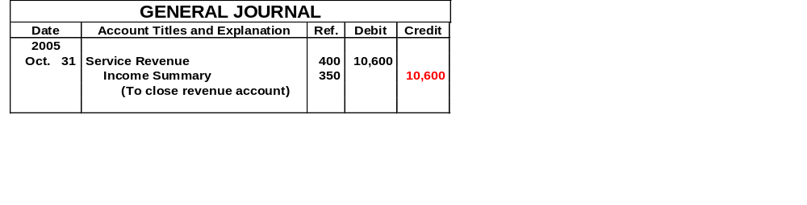
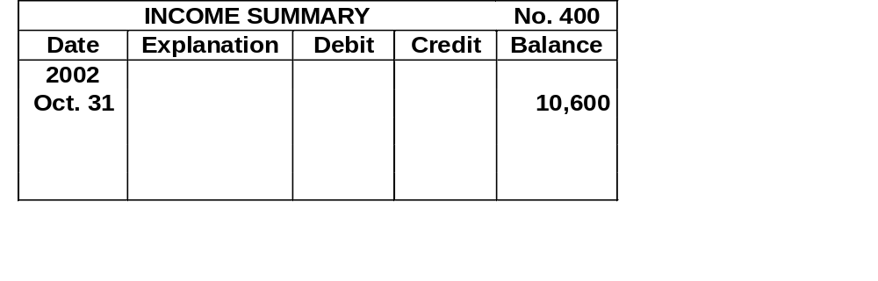

CLOSING ENTRIES JOURNALIZED
10,600
10,600

Slide 7
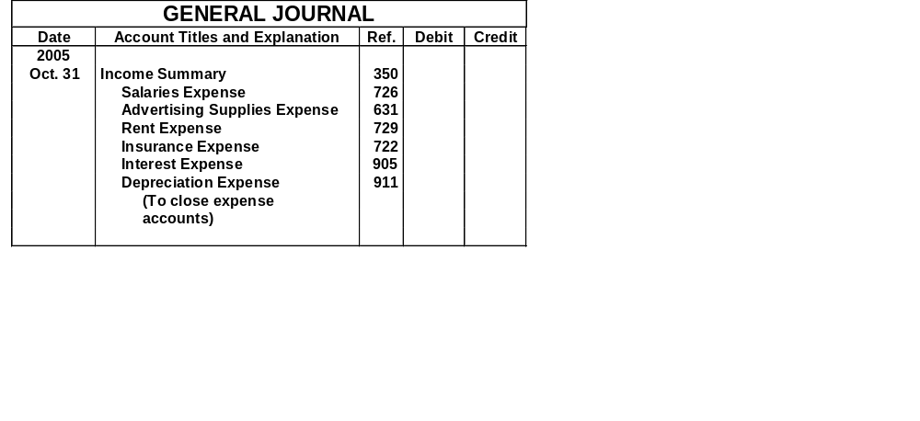
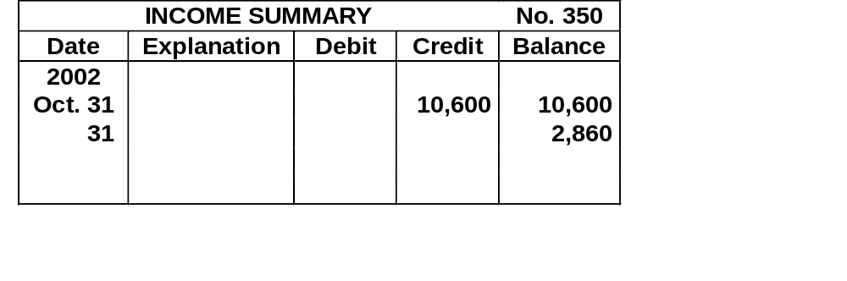
CLOSING ENTRIES JOURNALIZED
7,740
5,200
1,500
900
50
50
40
7,740
Notes:
Can’t fix the 2002 here-Help?

Slide 8

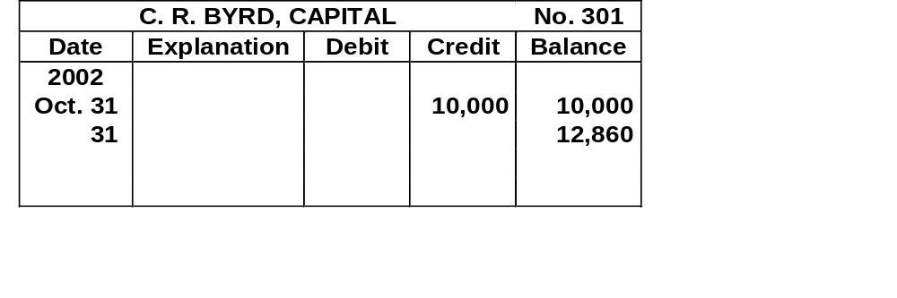
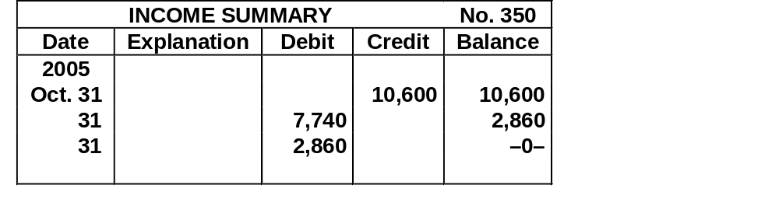
CLOSING ENTRIES JOURNALIZED
2,860
Notes:
Can’t Fix 301 to the year 2005.

Slide 9
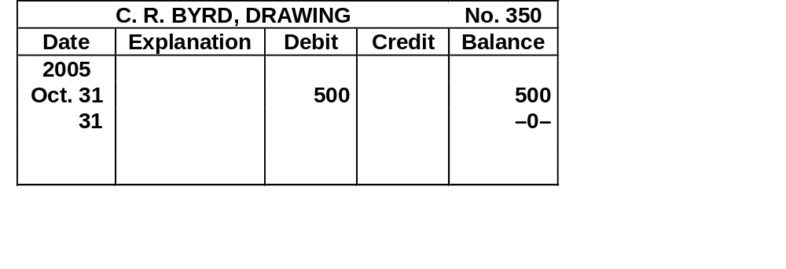
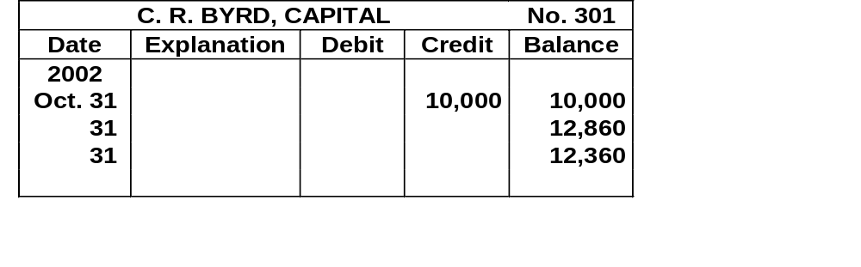
CLOSING ENTRIES JOURNALIZED
GENERAL JOURNAL
Date
Account Titles and Explanation
Ref.
Debit
Credit
2005
(4)
Oct. 31
C. R. Byrd, Capital
350
500
500
C. R. Byrd, Drawing
301
(To close net income to
capital)
500
500
Notes:
I am unable to Fix Account 301 to get to the year 2005. To much grouping and imported objects.

Slide 10
CAUTIONS RELATING TO CLOSING ENTRIES
Caution:
Avoid doubling revenue and expense balances
Owner’s Drawing does not move to the Income Summary account. Owner’s drawing is not an expense and it is not a factor in determining net income.

Slide 11
POSTING CLOSING ENTRIES
Temporary accounts
  All temporary accounts will have zero balances after posting the closing entries
  Temporary accounts (revenues and expenses) are totaled, balanced and double ruled
Owner’s capital
  Total equity of the owner at the end of the accounting period
  No entries are journalized and posted to owner’s capital during the year
Permanent accounts (assets, liabilities, and owner’s capital) not closed

Slide 12
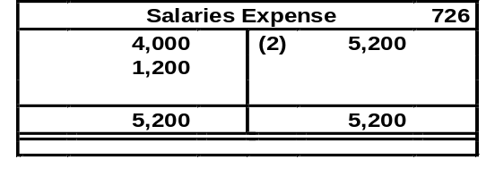
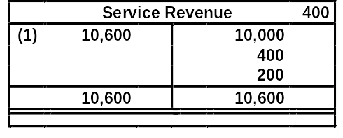
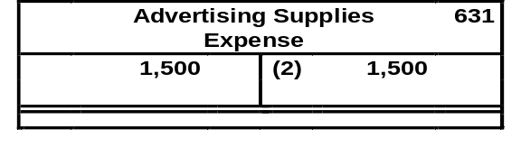
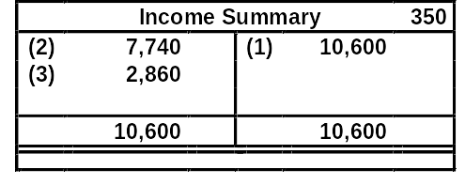
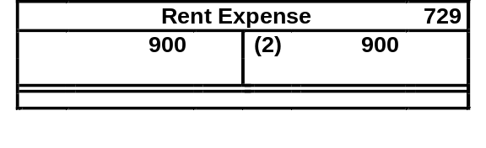
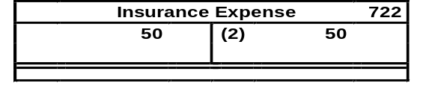
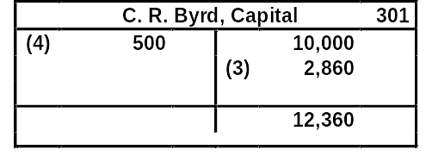
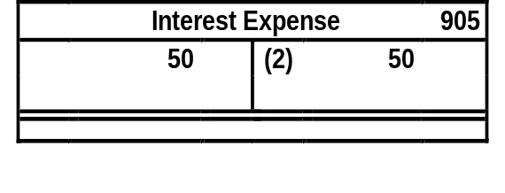
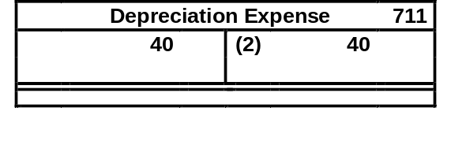
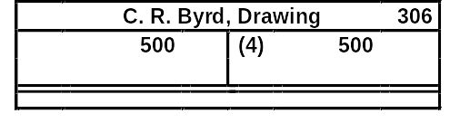
POSTING OF CLOSING ENTRIES
2
1
3
2
4

Slide 13
POST-CLOSING TRIAL BALANCE
  After all closing entries have been journalized the post-closing trial balance is prepared from the ledger.
The purpose of this trial balance is to
  prove the equality of the permanent account balances that are carried forward into the next accounting period.

Slide 14
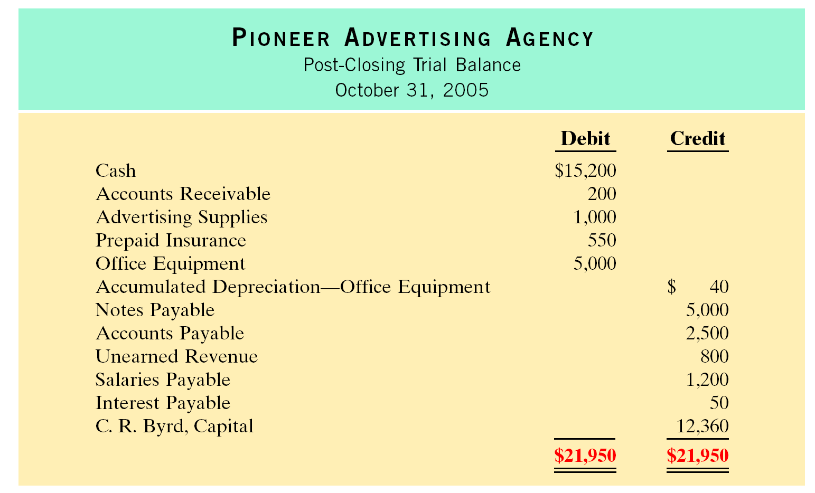
POST-CLOSING TRIAL BALANCE

Slide 15
STEPS IN THE ACCOUNTING CYCLE
1 Analyze business transactions
2 Journalize the transactions
3 Post to ledger accounts
4 Prepare a trial balance
5 Journalize and post adjusting entries

Slide 16
STEPS IN THE ACCOUNTING CYCLE
6 Prepare an adjusted trial balance
7 Prepare financial statements: Income Statement, Owner’s Equity Statement, Balance Sheet
8 Journalize and post closing entries
9 Prepare a post-closing trial balance

Slide 17
CORRECTING ENTRIES
STUDY OBJECTIVE 5
Correcting Entries
  errors should be corrected as soon as discovered
  correcting entries are unnecessary if records are free of errors
  can be journalized and posted whenever an error is discovered
  involve any combination of balance sheet and income statement accounts

Slide 18
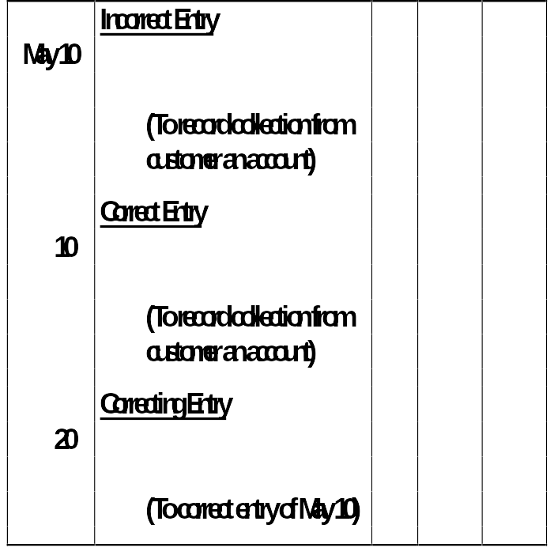
ILLUSTRATIVE EXAMPLE OF CORRECTING ENTRY 1
Cash 50
Service Revenue 50
Cash 50
Accounts Receivable 50
Service Revenue 50
Accounts Receivable 50

Slide 19
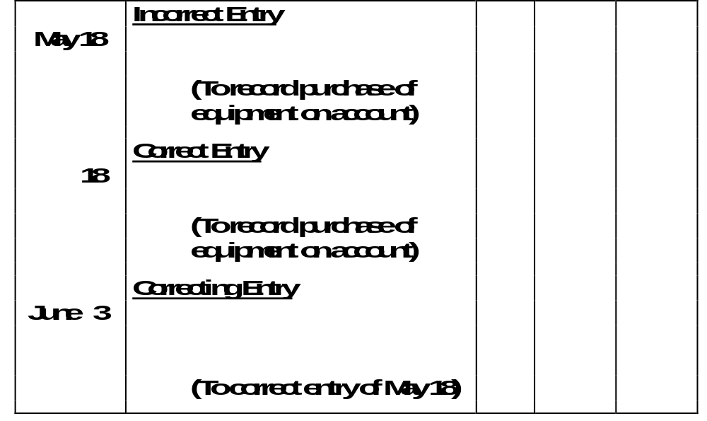
ILLUSTRATIVE EXAMPLE OF
CORRECTING ENTRY 2
Delivery Equipment 45
Accounts Payable 45
Office Equipment 450
Accounts Payable 450
Office Equipment 450
Delivery Equipment 45
Accounts Payable 405

Slide 20
The closing entry process consists of closing
  all asset and liability accounts
  out the owner's capital account
  all permanent accounts
  all temporary accounts

Slide 21
The closing entry process consists of closing
  all asset and liability accounts
  out the owner's capital account
  all permanent accounts
  all temporary accounts

Slide 22
STANDARD BALANCE SHEET CLASSIFICATIONS
Financial statements become more useful when the elements are classified into significant subgroups.
A classified balance sheet generally has the following standard classifications:
Current Assets Current Liabilities
Long-Term Investments Long-Term Liabilities
Property, Plant and Owner’s (Stockholders’) Equity Equipment
Intangible Assets
Assets Liabilities and Owner’s Equity

Slide 23

CURRENT ASSETS
Current assets
  Cash and other resources that are reasonably expected to be realized in cash or sold or consumed in the business within one year of the balance sheet date or the company’s operating cycle, whichever is longer
  Current assets are listed in the order of their liquidity
Operating cycle of a company
  This is the average time required to go from cash to cash in producing revenues
Examples
  Inventory, accounts receivable and cash

Slide 24
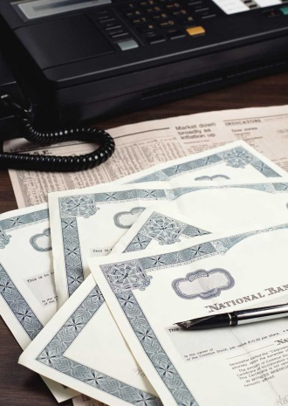
LONG-TERM INVESTMENTS
Long-term investments
  Resources which can be realized in cash
  Their conversion into cash is not expected within one year or the operating cycle, whichever is longer
Examples
  Investments in bonds of another company or investment in land held for resale
XYZ stock

Slide 25
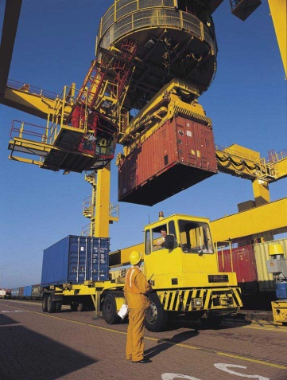
PROPERTY, PLANT, AND EQUIPMENT
Property, plant, and equipment
  Tangible resources, relatively permanent nature, used in the business, and not intended for sale
Examples
  Land, buildings, and machinery

Slide 26

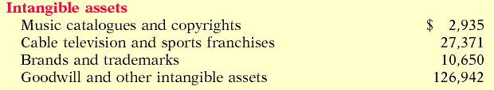
INTANGIBLE ASSETS
Intangible assets
  Non-current resources that do not have physical substance
Examples
  Includes patents, copyrights, trademarks, or trade names, gives the holder exclusive right of use for a specified period of time

Slide 27
CURRENT LIABILITIES
Current liabilities
  Obligations reasonably expected to be paid from existing current assets or through the creation of other current liabilities within one year or the operating cycle, whichever is longer
Examples
  Accounts payable, wages payable, interest payable and current maturities of long-term debt

Slide 28
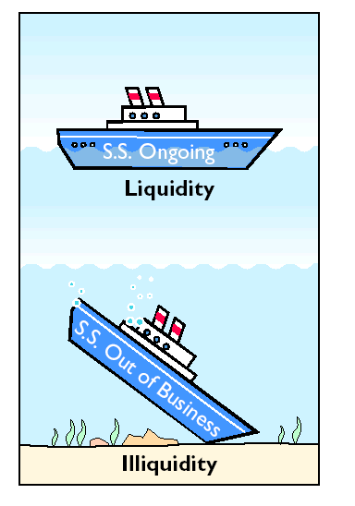
CURRENT LIABILITIES
Liquidity is the ability of a company to pay obligations that are expected to become due within the next year or operating cycle.

Slide 29
LONG-TERM LIABILITIES
Long-term liabilities Obligations expected to be paid after one year
Examples
  Long-term notes payable, bonds payable, mortgages payable, and lease liabilities

Slide 30
OWNER’S EQUITY
The content of the owner’s equity section
  Varies with the form of business organization
Proprietorship
  A single owner’s equity account called (Owner’s Name), Capital
Partnership
  Separate capital accounts for each partner
Corporation
  Called stockholders’ equity, and it consists of two accounts: Capital Stock and Retained Earnings

Slide 31
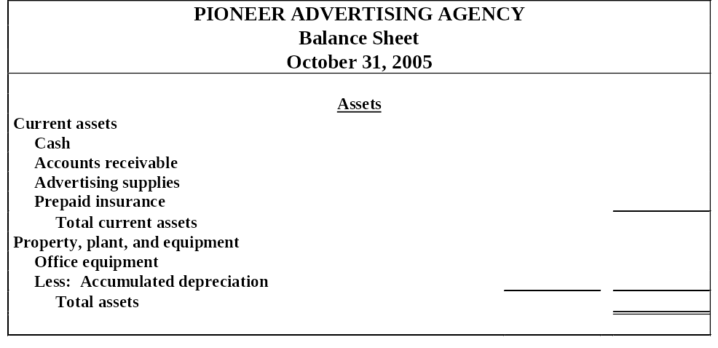
CLASSIFIED BALANCE SHEET IN ACCOUNT FORM
$ 15,200
200
1,000
550
16,950
$5,000
40 4,960
$21,910
A classified balance sheet
1 availability of assets to meet debts
2 claims of short- and long-term creditors on total assets

Slide 32
CLASSIFIED BALANCE SHEET IN REPORT FORM
Liabilities and Owner’s Equity
$ 1,000
2,500
50
800
1,200
5,550
4,000
9,550
12,360
$21,910
Current liabilities
Notes payable
Accounts payable
Interest payable
Unearned revenue
Salaries payable
Total current liabilities
Long-term liabilities
Notes payable
Total liabilities
Owner’s equity
C. R. Byrd, Capital
Total liabilities and owner’s equity
The balance sheet is most often presented in the report form, with the assets above liabilities and owner’s equity.

